Slide 1
Minnesota Amateur Sports Commission
House Capital Investment
10:15 AM
February 18, 2025
Notes:
Thank You
Intro

Slide 2
Minnesota
Amateur Sports Commission
National Sports Center Foundation
Created in 1987 by State of MN
Provides strategic guidance and planning for the construction of athletic facilities throughout MN
Governing entity of the National Sports Center
Acts as a convener and coordinator for statewide amateur sports organizations
Created in 1990 by State of MN/MASC
Formed to manage National Sports Center
501(c)3 non-profit corporation
Largest amateur sports complex in the world
Grounds for amateur sports education and analysis opportunities
Notes:
MASC background
Small agency tasked with driving economic impact through sports tourism and promoting the benefits of amateur sports
We provide strategic guidance for facilities and act as a convener for amateur sports organizations statewide
Popularly known for governance of the National Sports Center in Blaine
NSC, Relationship to MASC
In 1990 the Commission created a non-profit, the National Sports Center Foundation, to manage the Sports Center
Complex is the largest of its kind in the world, home to 4M visitors each year

Slide 3
National Sports Center
The National Sports Center (NSC) is the State of Minnesota’s premier sports facility located in Blaine, spanning 700 acres and featuring:
Buildings: 23
Athletic fields: 60 (3 indoor)
Ice sheets: 8
Indoor courts: 2
18-hole golf course
Notes:
For those that aren’t familiar, NSC spans 700 acres and features
23 buildings
60 athletic fields
8 ice sheets
2 indoor courts
18-hole golf course

Slide 4
National Sports Center Impact
$90 Million
4 Million
80+
1
Annual Economic Impact
Annual Visits
Operators on Campus
Campus
50 full-time staff
200+ part-time and seasonal workers
1,000+ 1099 contractors (officials)
Operating subsidy: $0
USA CUP: world’s largest soccer tournament at a single facility, brings 16,000 athletes from 25+ states and 15+ countries
Private businesses
Non-profits
100+ internal programs
Notes:
Small full-time staff supported by 1,000+ contractors and 200+ pt workers… generate events and activities that drive…
80+ operators to campus
4 million annual visits
And generates $90 million in annual economic impact for the state
Our flagship event is USA CUP, an international youth soccer tournament that brings 16,000 athletes to Minnesota from 25+ states and 15+ countries
Notably, this impact and activity is sustained without any operating dollars from the state

Slide 5
National Sports Center - FCA Report
NSC Super Rink
Minnesota’s Largest Ice Arena
Est: 1998 (front 4 ice sheets), 2006 (back four ice sheets)
Current Replacement Value: $125M
$66M (front four)
$59M (back four)
Super Rink Deferred Maintenance: $58M
$39.68M (front four, Crisis-Rated)
$18.2M (back four, Poor-Rated)
The Department of Administration’s Minnesota Enterprise Real Property Facility Condition Assessment Report is a comprehensive report depicting the conditions of all of Minnesota's state-owned buildings in a standardized and objective means. This report is intended to be used to compare agency buildings, and to justify bonding projects and asset preservation funding.
State of MN Crisis-Rated Deferred Maintenance
($275M)
$205,967,903
$78,957,259
Replacement Value
Deferred Maintenance
All Other State Bldgs ($235.3M)
NSC Super Rink ($39.7M)
Notes:
Throughout its history, the facility has been maintained primarily by the Foundation, with periodic support through bonding dollars and CAPRA dollars for emergency repairs
As we examine the facility’s capital needs to sustain its level of operation, we utilize the Dept. of Administration’s Facility Condition Assessment report
The facility as a whole has a replacement value of nearly $206M, and its deferred maintenance is nearly $79M
Greatest need is in the Super Rink
Current replacement value of the Rink is $125M, and its deferred maintenance costs are $58M, all of which is rated by the report as being in crisis or poor condition
Demonstrating the scale of the Rink’s need, see the pie chart of the Rink’s crisis-rated deferred maintenance compared to all other state buildings combined

Slide 6
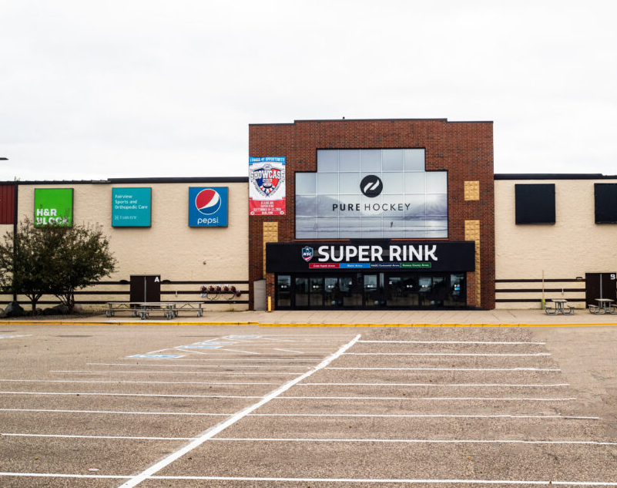
Super Rink Renovation Cost Estimate
SCOPE​ | ASSET PRESERVATION​ | NEW BUILD​ | TOTAL COST​
B32 Engineering Estimate | ​ | ​ | ​
Ice Plant Replacement & Room Buildout​ | $13,800,000​ | $0​ | $13,800,000​
Accessible Boards​ | $1,000,000​ | $0​ | $1,000,000​
Lighting & Electronics​ | $600,000​ | $0​ | $600,000​
Low E Ceiling​ & Internal Finishes | $3,200,000​ | $0​ | $3,200,000​
Dehumidification​ | $4,900,000​ | $0​ | $4,900,000​
Sub-Total​ | $23,500,000​ | $0​ | $23,500,000​
$23.355M
$8.6M
Original Request
Governor's Recommendation
Notes:
As Super Rink infrastructure reaches the end of its anticipated lifespan, the facility can no longer tolerate one-off repairs and needs significant renovation
Engaged B32 Engineering to map the scope and cost of necessary changes – identified a need of about $23M to support these critical upgrades
Ice plant replacement (R-22 changeout, no longer legal to purchase)
Dehumidification
Lighting and electronics
Low E ceiling and internal finishes
Accessible boards

Slide 7
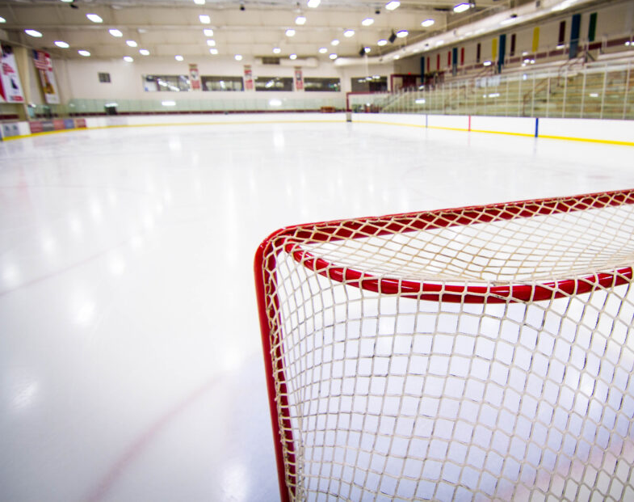
James Metzen Mighty Ducks Ice Arena Grant Program
Dual mission:
Eliminate use of R-22 refrigeration systems
Improve indoor air quality in ice arenas
$2.5M
$900,000
Original Request
Governor's Recommendation
Notes:
Like the Super Rink, ice arenas across the state are still working to fund their R-22 changeout
To support this statewide need, we requested additional funding to the James Metzen Mighty Ducks Ice Arena Grant Program
Provides financial assistance to help eliminate use of R-22 refrigeration systems as well as improve arenas’ indoor air quality
Program receives consistent stream of inquiries from rinks, enough demand that previous awards have been less than the maximum requested/permitted

